Slide 1
Microsoft Interview Coaching Program
Week 1 - Intro

Slide 2
Agenda
Meet the coaches
Program Format
Program Expectations
TEBOW IT
Exercise
Homework

Slide 3
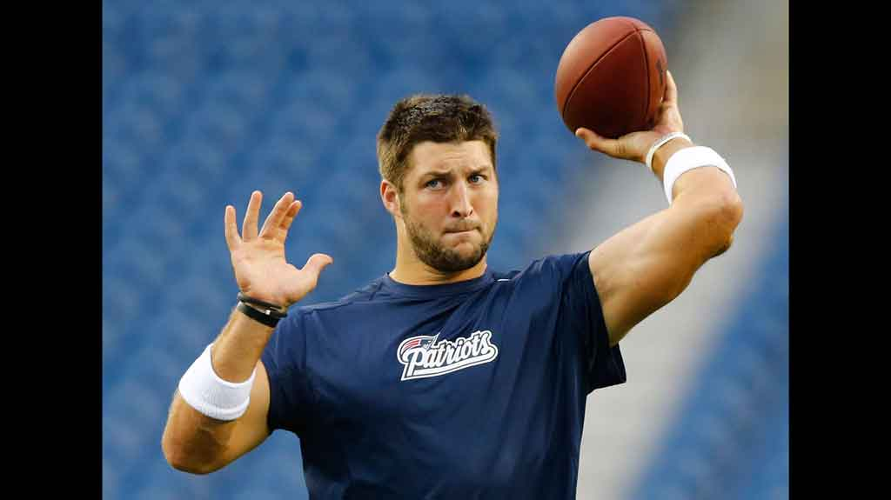
This is Tim Tebow. You will never forget him after today.

Slide 4





MICP Team (pictured left to right)
Software Engineer Interview Coaches
Dheeraj Sarpangal – Principal Group Engineering Manager, Dynamics 365
Taylor Garren – SWE II, Office Engineering
Deepika Tunikoju – SWE II, Office Engineering (not pictured)
University Recruiting
Kim Nguyen – University Recruiter, Program Manager
Content Creation
Kasey Champion – Content Developer 2
Executive Sponsor
Sumit Chauhan – CVP, Office Product Group

Slide 5
MCIP Team Bios

Slide 6
Dheeraj Sarpangal
15 years experience at Microsoft
10 years experience managing teams/employees
Conducted hundreds of technical interviews
Connect with me on LinkedIn

Slide 7
Taylor Garren

Slide 8
Deepika Tunikoju

Slide 9
Kim Nguyen

Slide 10
Kasey Champion

Slide 11
Sumit Chauhan

Slide 12
Why are we doing this?
Give
Give people a chance and a competitive advantage to get a job at Microsoft
Network and connect
Network and connect with students across the world
Hire
Hire talent from a wide range of backgrounds for Microsoft
Strengthen
Strengthen Microsoft’s brand and image

Slide 13
Program Format
One hour online coaching session
Use a web cam – we want to see you!
Join our slack channel!
Available days/times (PST) for coaching sessions
Tuesday 8 AM
Wednesday 12 PM
Thursday 6 PM
Eight weeks of training
Weekly homework assignments

Slide 14
Course Topics Overview
Intro
Strings
Algorithms
Data Structures
Data Structures
Arrays
Lists
Stacks
Queues
Trees
Heaps
Hash Tables
Object Oriented Programming
Conclusion

Slide 15
Program Expectations
Ask lots of questions
Practice
Collaborate with your teammates

Slide 16
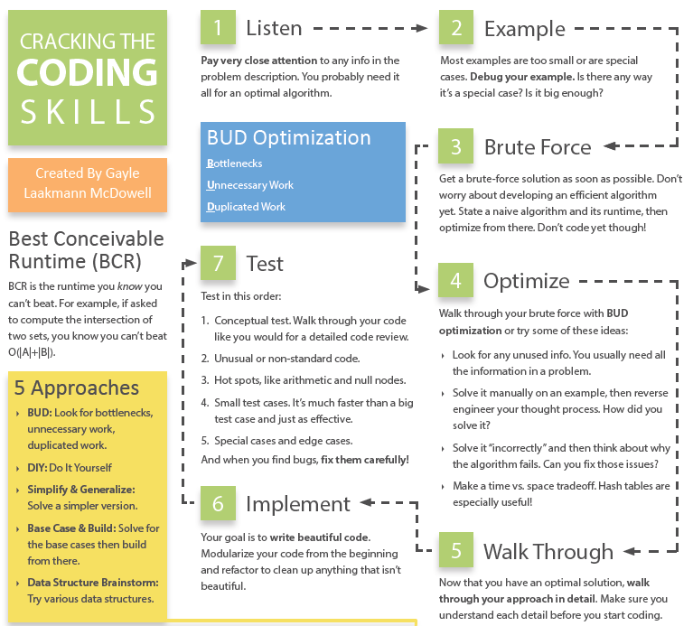
Coding Interview Approach

Slide 17
TEBOW IT
Talk
Examples
Brute Force
Optimize
Walk Through
Implement
Test
Notes:
Not uncommon to spend most of the time in the first part!

Slide 18
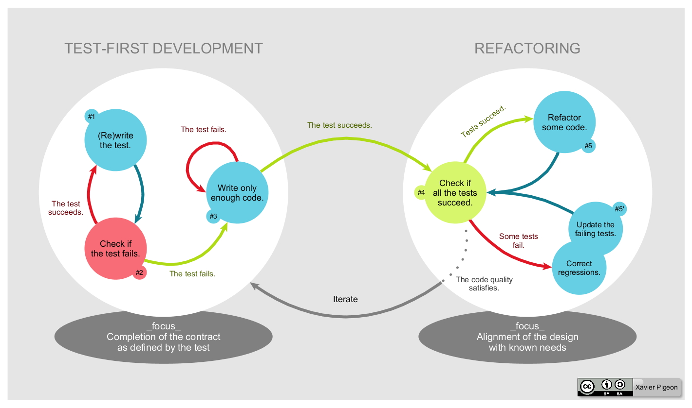
TDD – Test Driven Development
Notes:
Never erase your test cases!!

Slide 19
What is “good code”?
Correct
Efficient
Simple
Readable
Maintainable

Slide 20
Exercise: Integer Palindrome with a twist
A Palindrome is a number that reads the same forward as it does in reverse. For example, 12321 is a palindrome because it reads the same going from left to right as it does going right to left. Most numbers can be made into palindromes by taking the original number, reversing the digits, then adding the original number to the reversed digits. If that number isn’t a palindrome, then repeat the same process until you reach a palindrome. Most numbers can be made into palindromes by repeating this process, but some numbers don’t converge. During this process, if the number becomes larger than 1,000,000 and still doesn’t form a palindrome, then return false.

Slide 21
T – Talk (/Listen/Clarify)

Slide 22
E – Examples (/Test/TDD)
Sample Input | Equivalence Class | Output

Slide 23
B – Brute Force

Slide 24
O - Optimize

Slide 25
W – Walk Through

Slide 26
I - Implement

Slide 27
T - Test

Slide 28
Homework Assignment
Week 1 Assignment – we’ll review this in Week 2
Caesar Cipher
Stretch goals
atoi and itoa
Challenge: Reverse Parse Multi-Byte

Slide 29
Caesar Cipher
The code you will write is based on the “Caesar Cipher” where each letter is shifted a certain number of places left or right through the alphabet. The alphabet is treated as being circular so that the first letter follows after the last letter, and the last letter precedes the first letter. These ideas will be applied separately to uppercase letters, lower case letters, and digits. For example, with a shift of 1, ‘A’ becomes ‘B’, ‘Z’ becomes ‘A’, ‘a’ becomes ‘b’, ‘z’ becomes ‘a’, ‘0’ becomes ‘1’, ‘9’ becomes ‘0’. Spaces, punctuation, and any other symbols are unaffected in this scheme. Your task is to write a function to encrypt a string using this Caesar Cipher.
INPUT FORMAT
Your function will take an input string that begins with a number representing the shift. The number will be in the range -1000000000 to 1000000000 (negative 1 billion to 1 billion). The number is followed by a colon (‘:’). The rest of the line consists of a string of 1 to 200 arbitrary characters and represents a fragment of the text to be encrypted.
OUTPUT FORMAT
Output will be the corresponding encrypted text fragment
SAMPLE INPUT:
1:some text
SAMPLE OUTPUT:
tpnf ufyu

Slide 30
ATOI and ITOA
int atoi(string input) – convert a string to an integer
string itoa(int input) – convert an integer to a string

Slide 31
Reverse Parse Multi-Byte
You are to implement a function with the following prototype
int NumChars(char* begin, char* end)
The purpose of the function is to determine whether the last character in the buffer defined as the bytes between begin and end is English or Japanese. Japanese characters are two bytes long and always have a 1 in the high bit of the high byte. The low byte of a Japanese character can have either 1 or 0 in the high bit. English characters are one byte long and always have a 0 in the high bit. The function is expected to return the following:
2 if last character is Japanese (two bytes)
1 if last character is English (one byte)
0 if the data in the buffer is malformed

Slide 32
Helpful Resources
Cracking the Coding Interview
We’re going to try to buy this book for you!
Microsoft College Code Competition
Code Complete, 2nd edition – “good code”

Slide 33

Week 1 Takeaway
Don’t miss out on a job because you forgot to TEBOW IT!

